Slide 1
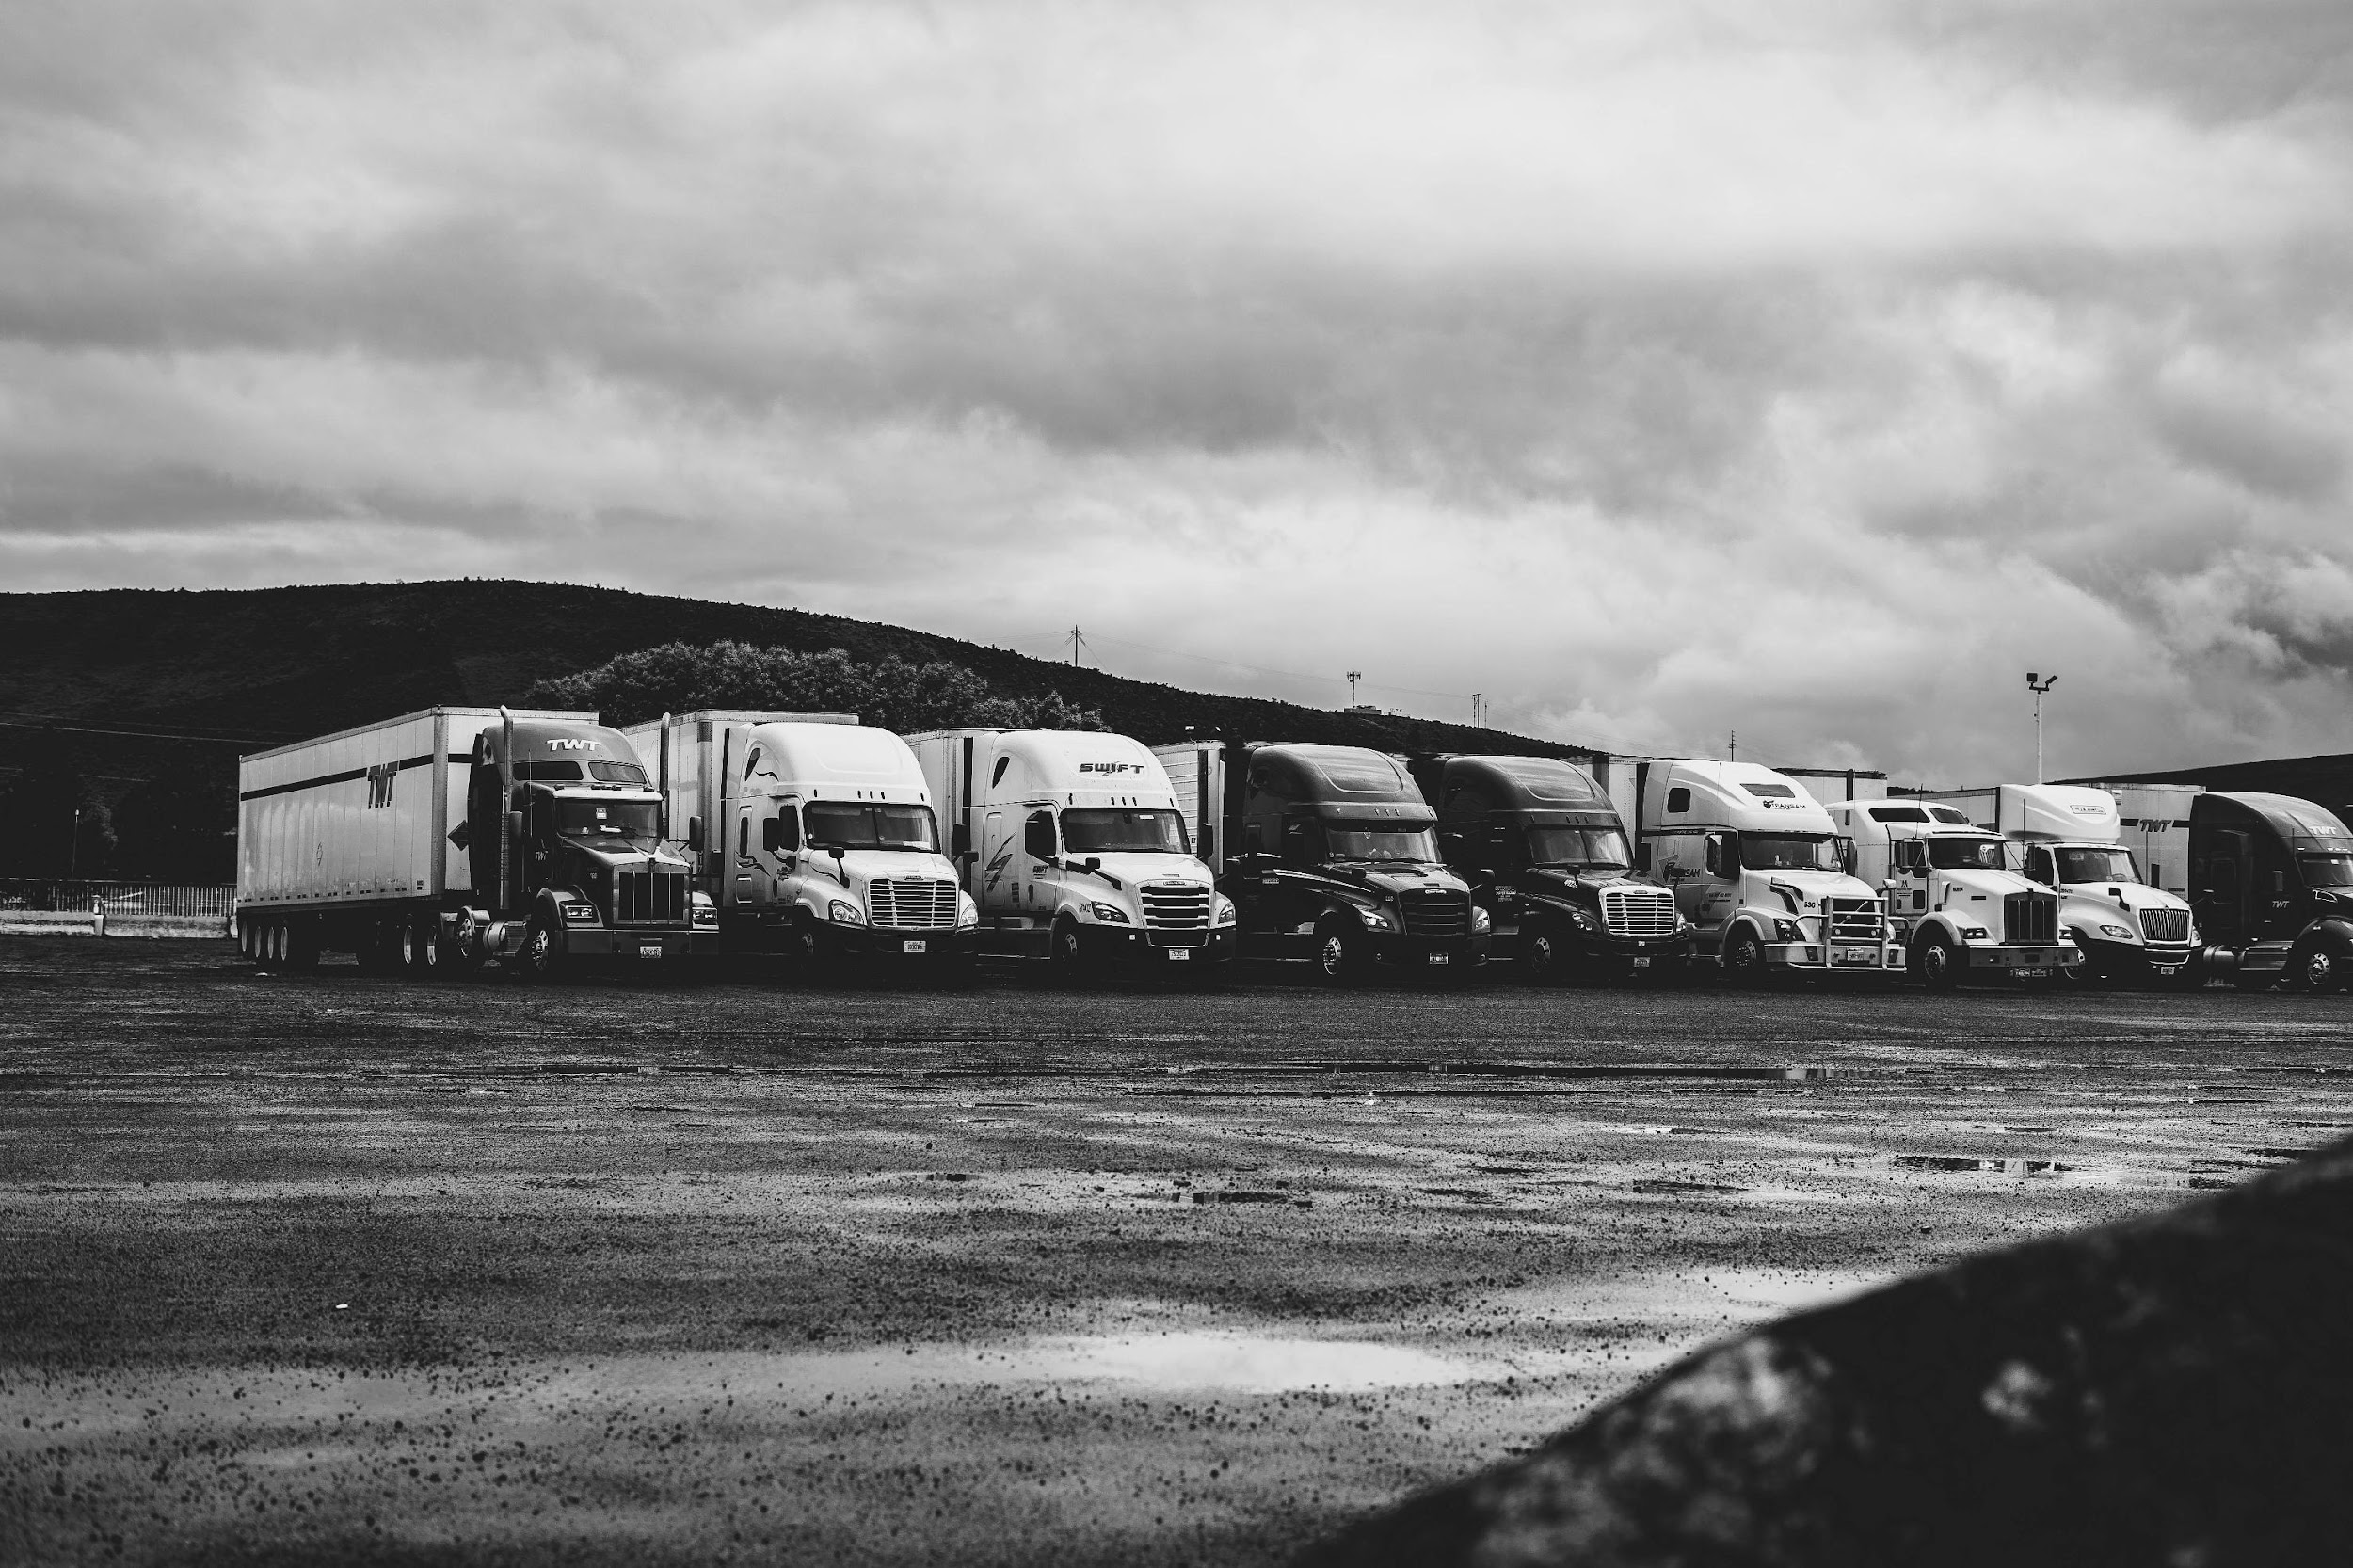
LoadEx
Let us handle everything

Slide 2

LoadEx
Group Members
Rohma Noor 192400020
Faran Zahid 192400009
Aroosh Khizar 181370162
Nayab Fatima 181370175
Supervisor Name : Muhammad Adrees Chaudhary

Slide 3
Table of contents
01
02
03
04
05
06
Problem Statement
Scope
Proposed Solution
Learning Outcomes
Documentation
Mockups

Slide 4
Problem Statement
Now a days when people are moving towards technology, but moving goods from one place to another is still a problem there is no online or technical system for that purpose There is no proper records. And specially for business-mans who want to transfer their heavy goods outside the city. This is still a problem.

Slide 5

Abstract
LoadEx is an improved web based application used to transfer goods from one place to another, there were many other system previously available but they do not provides live tracking facility of orders , providing helpers to customer and maintain their budget and also generates discounts. We provide all these new features with other previously existing features of existing systems.

Slide 6
Capstone 1 feedback

Slide 7
Panel remark
only implemented signup and login take order use case
Database is incorrect
implementation is not 20%
Usecases are not written correctly.

Slide 8
Documentations

Slide 9
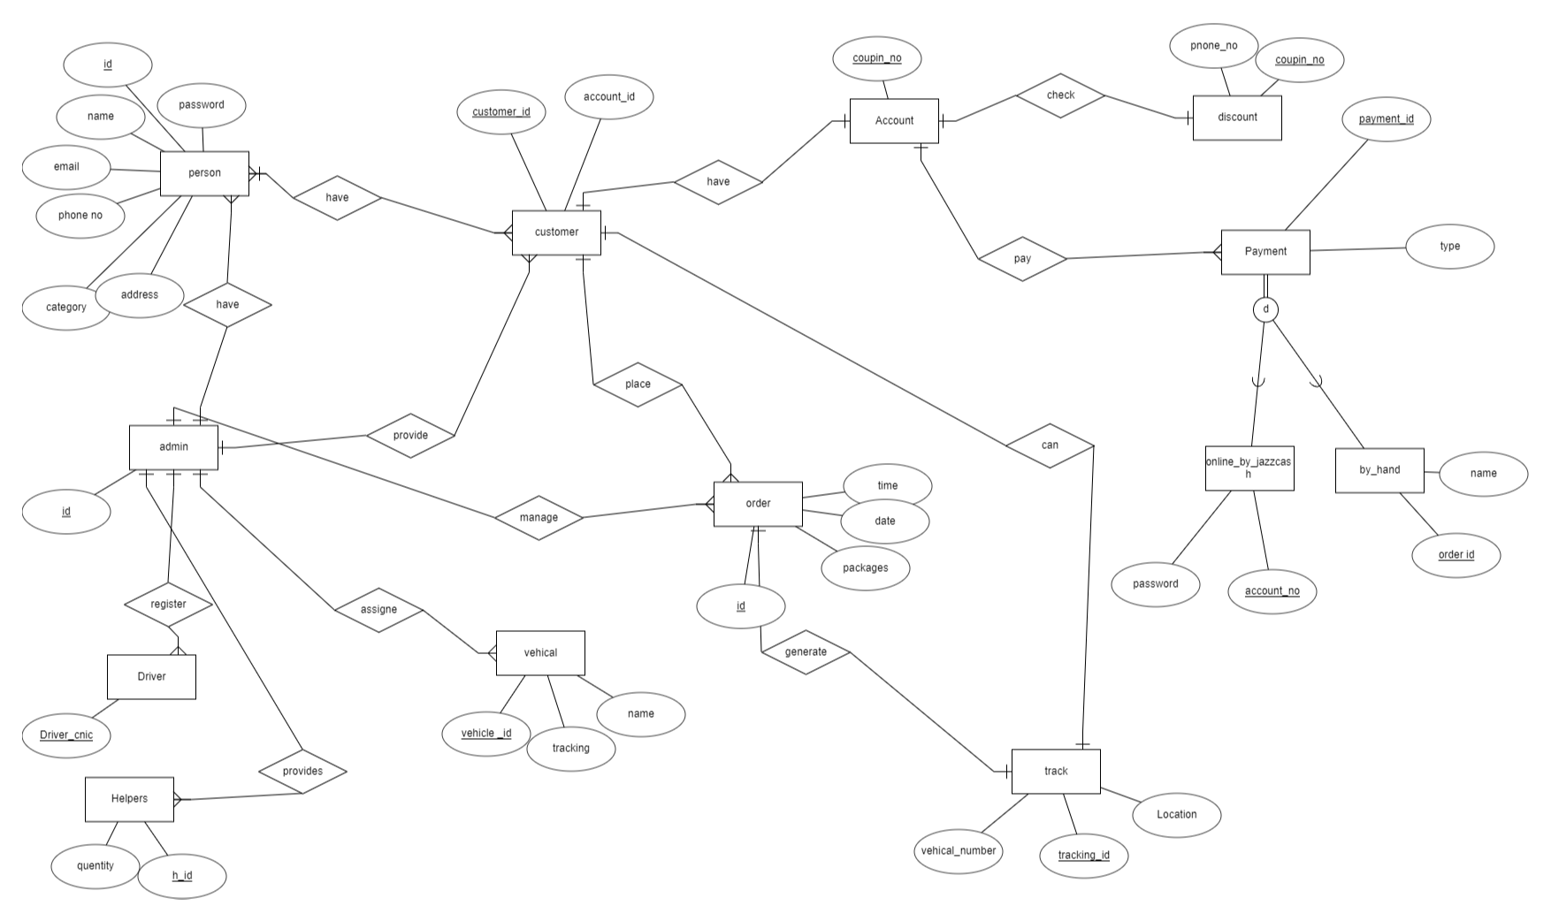
ERD

Slide 10
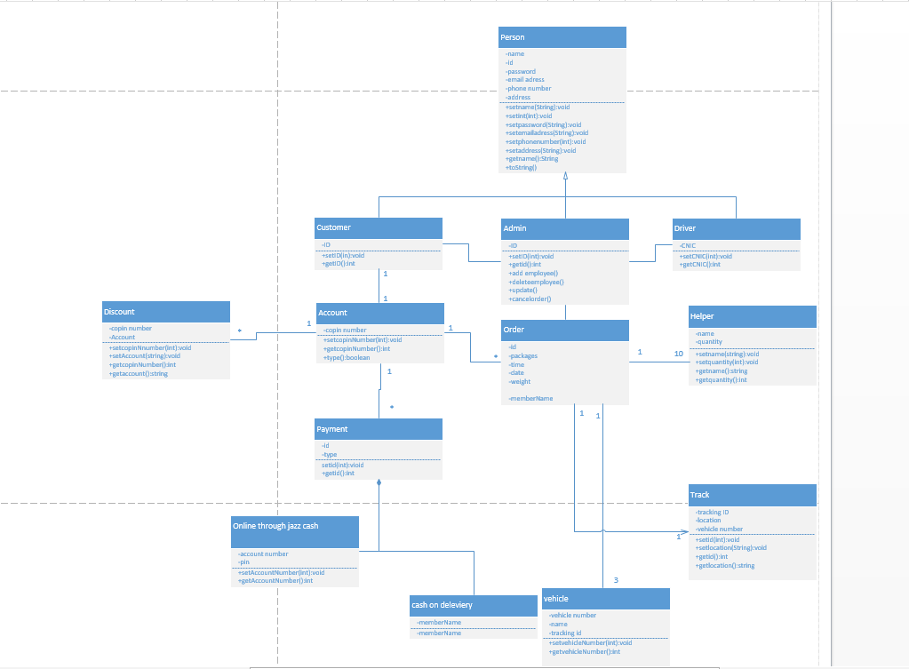
Class Diagram

Slide 11
Thank You

